Slide 1
Helios

Slide 2
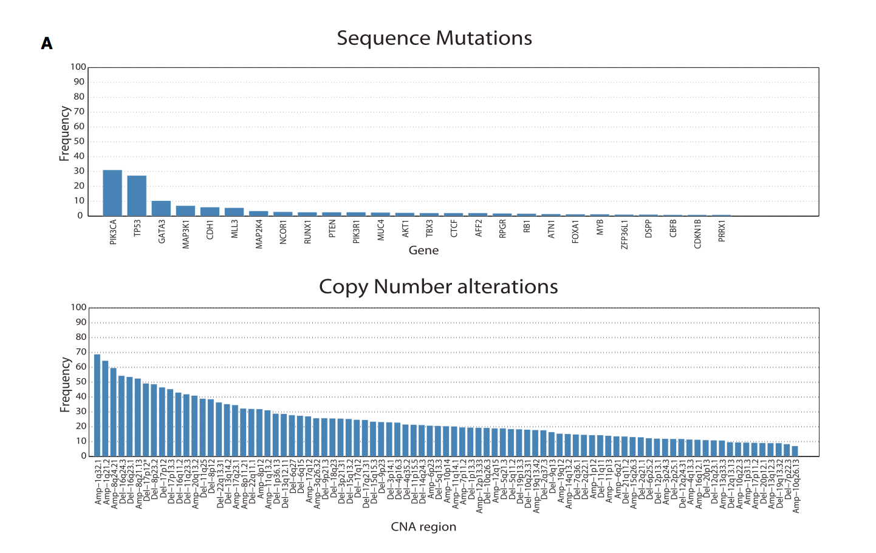
Motivation
Notes:
Very few point mutations in >5% of patients
Most recurrent genetic lesions are the SCNAs (87 vs 6 > 5%)
Oftentimes lesions have many genes and no characterized drivers
Easier to find driver genes in point mutations due to nature of precise location

Slide 3
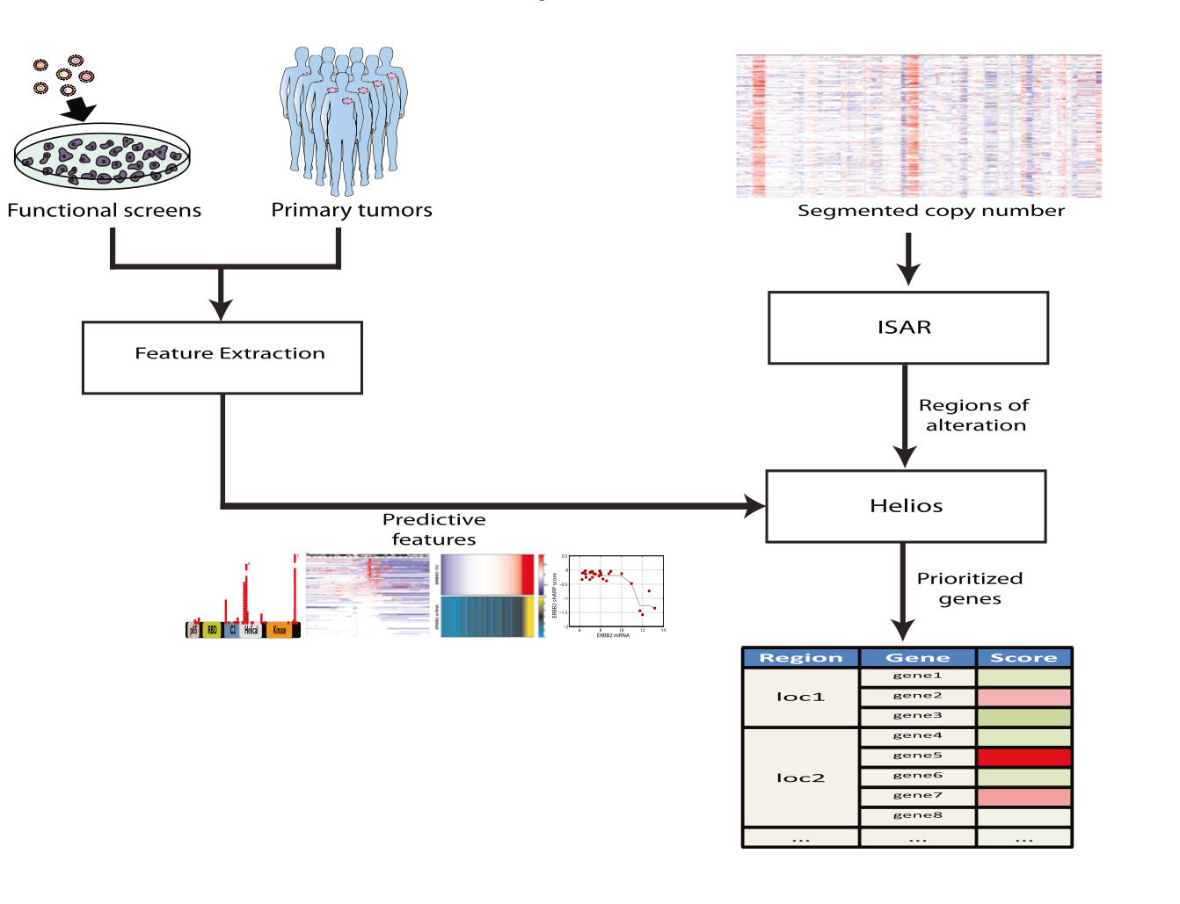
Development of Helios
Notes:
Number of different experiments that can be used, they decided to use combination of primary tumor SCNA, point mutations, gene expression and RNAi screens and create some type of score
Sequence, copy number , Expression, RNAi

Slide 4
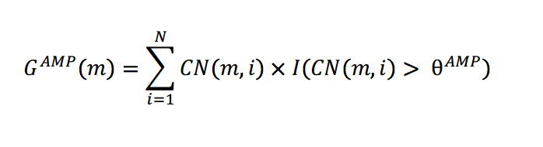
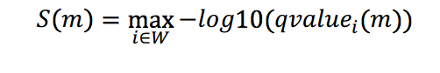
ISAR
Gistic Method
CN(m,i) = copy # of marker m in sample I
I = indicator function
Θ = Aberration threshold
ISAR
W = set of window sizes
I = Window size used
Qvalue = based on local distribution
m = marker
Notes:
Step 1 is to identify the altered regions of the chromosome
Typical algorithms like GISTIC do complete genome scans whereas ISAR does more local scans
Identification of significantly altered regions
Different window sizes will excel at getting different types of data. Small windows for small focal regions, large windows for large aberrations
Q value above user defined Tp is part of a region of alteration, look at regions above user defined Tr

Slide 5
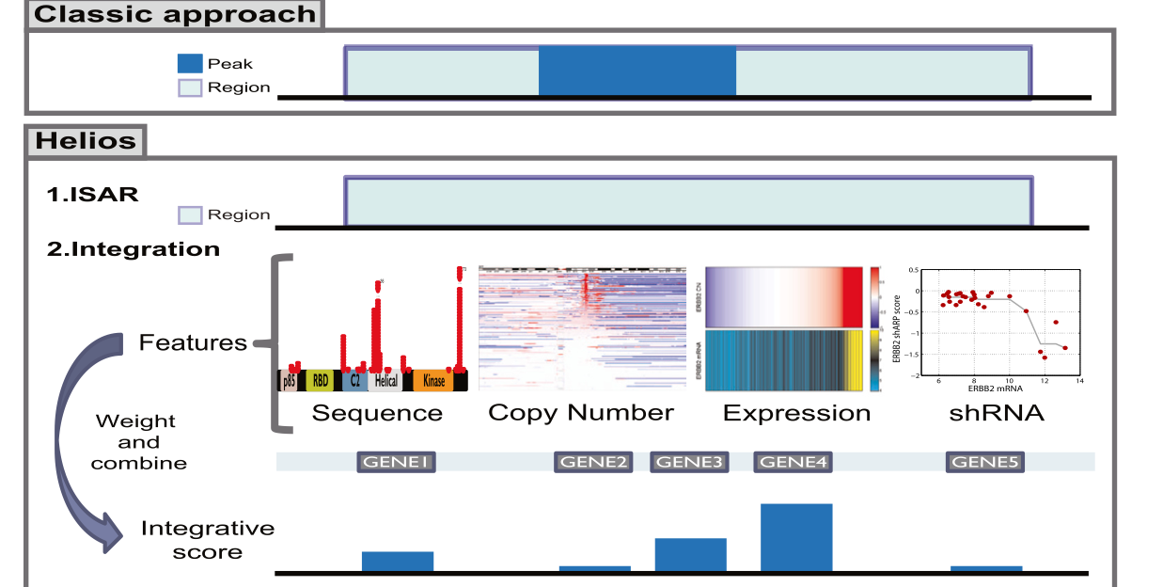
Helios
Notes:
Seeks to exploit additional properties to implicate likely driver genes targetec by the SCNA
Framework for combining multiple signals that might lack power individually into a single score
Looks at the Full SCNA region and then prioritizes genes within each region using a Bayesian approach

Slide 6
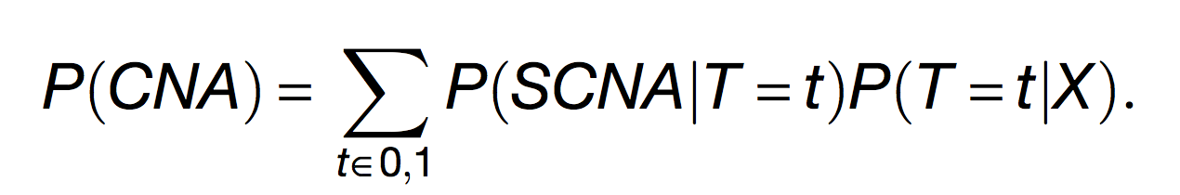
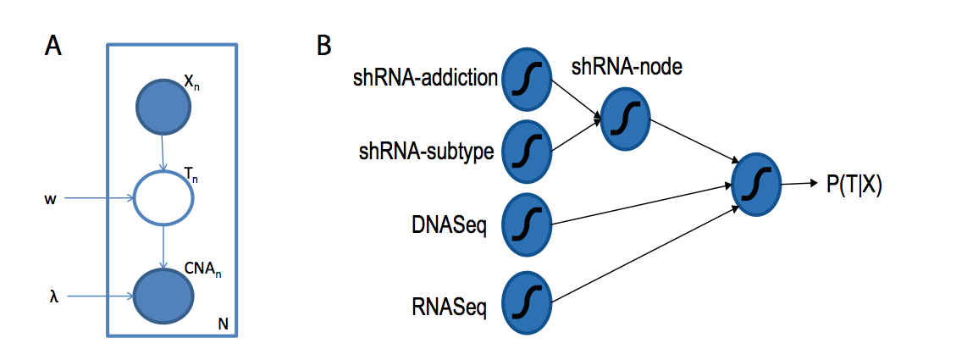
Helios
Notes:
Integrative Bayesian approach to rank driver genes within each region. Discriminates driver from passenger genesy by integrating the copy number alteration information with cues from different data sources (X)
Iterates between two stages until convergence
1. learning the parameters to distinguish passengers and drivers (SCNA and X)
2. recomputing the P that each gene is a driver using the parameters

Slide 7
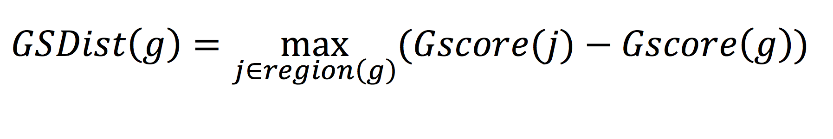
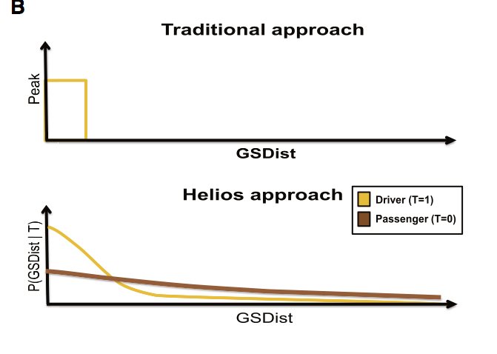
P(SCNA|T=t): Modeling of Copy Number
Find Peak genes Independent of chromosomal region because distribution between regions is much larger than in region
j = max in region
g = gene
Notes:
Calculate G-Score based on relative to others within same region
Largest G score in a region would have G score of 0
Change in cutoff bc driver genes are likely to be most altered genes of their region, translates into a GSDist distribution that exp ecreases from 0 with small varianc

Slide 8
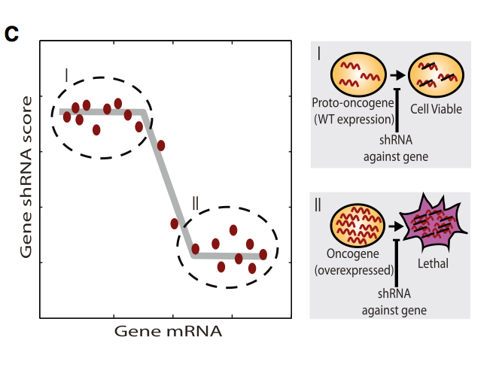
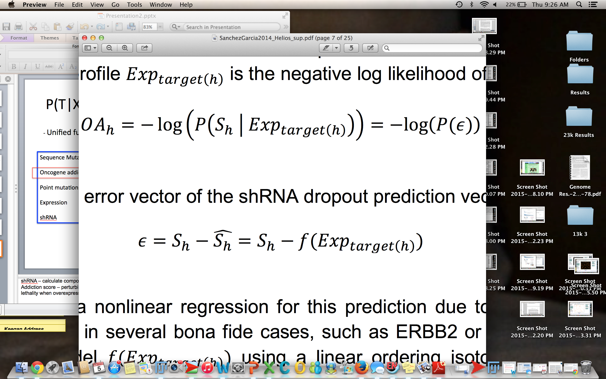
P(T|X) – Modeling Additional Info
- Unified function made up of cues from all data
Sequence Mutations
Oncogene addiction
Point mutations
Expression
shRNA
X = 1 Driver
X
X = 0 Passenger
Notes:
Sequence muts – Used MutSig to compute statistical significance of reccurrence of mutations; used log transformed p-value as a feature for Helios
Expression – RNA-Seq to identify genes that are not expressed or are not driven by SCNA
Expressed genes – Estimated percentage of samples in which each gene is above a percentile
shRNA – calculate composite stats combining the shRNA sigs with gene expression and breast cancer subtype info
Addiction score – perturbing oncogene produces dramatic changes in the cell, look at genes that show increased lethality when overexpressed to be likelier candidates
Oncogene score for a hairpin h with shRNA dropout Sh that targets a gene with expression profile Exp target is the negative log likelihood of Sh given Exp target h

Slide 9
P(T|X)
Notes:
Extended the logistic regression model by introducing additional layers of sigmoid functions; each individual feature connects to a node representing a single sigmoid fxn, these are combined into intermediary nodes and/or connected directly to a final node

Slide 10
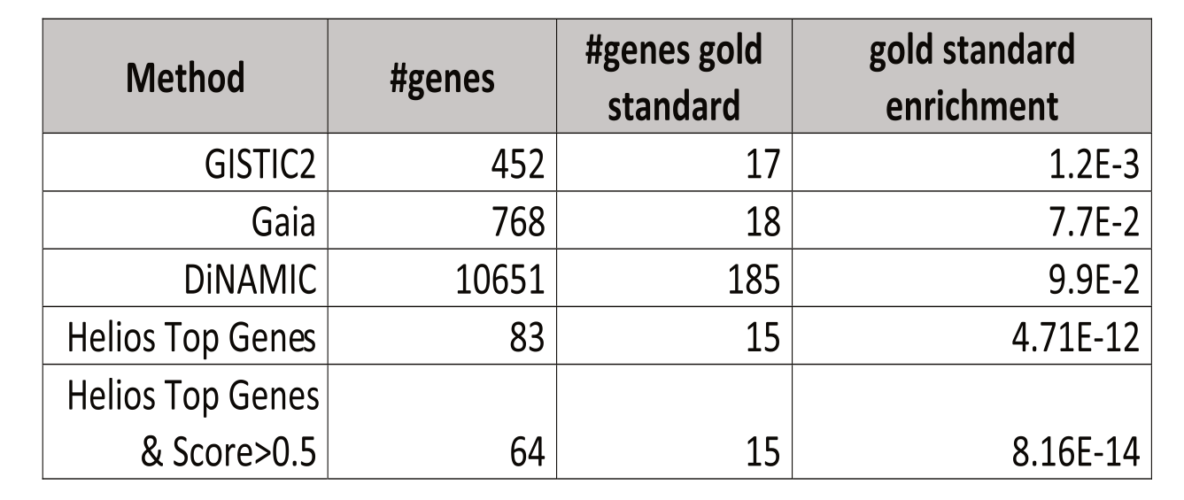
Results
Using Helios, identified 64 candidate drivers using primary and cell line
Notes:
Gold standard genes is list of 330 genes from known amplified oncogenes.
Largest G-score per region to find gold standard – Helios does this with only 64 genes, thus achieves the same sensitivity by signifcantly increases specificity. Compare hyperfeometric enrichment P-value. EG. Gistic found 30 peaks containing 452 genes, out of which 17 are annotated in the gold standard

Slide 11
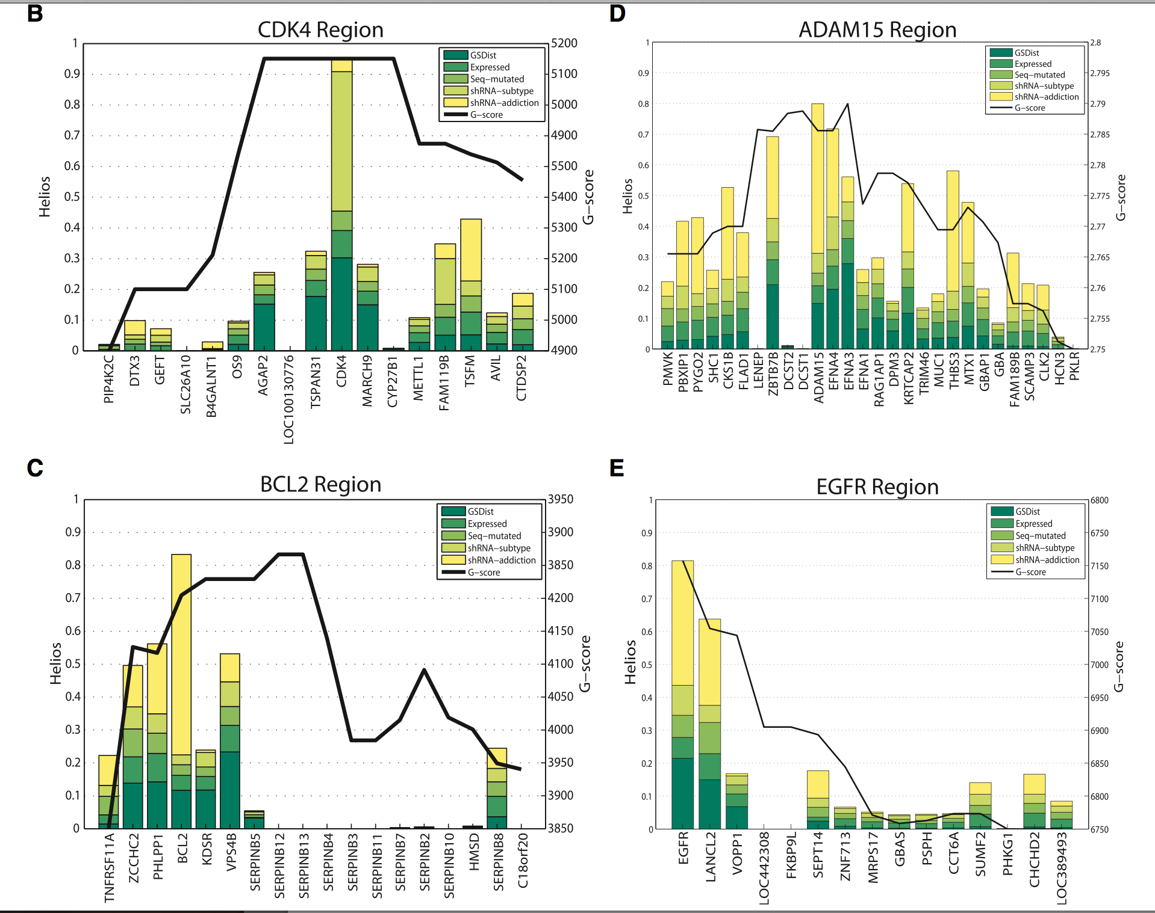
Results
Notes:
CDK4 shares same copy number with five closest neighbors, but lethality from shRNA screen raises score
BCL2 – copy nuumber isn’t high at all but oncogene addiction score is high
ADAM 15 or EGFR have combinations of features

Slide 12
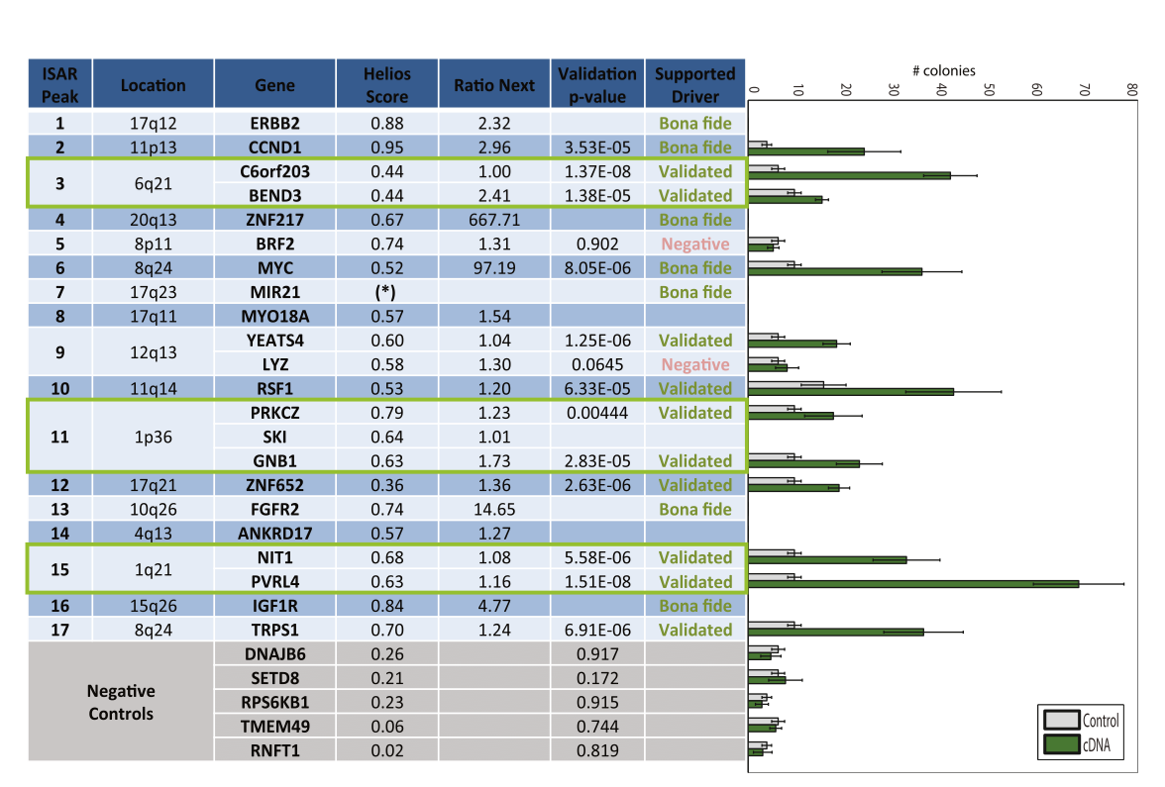
Results: Validation
Notes:
Looked at 17 regions identified with ISAR and looked at top scoring genes (can be more than 1)
Bona Fide means has been shown multiple times in the litereature
In vitro validation – Clone overexpression genes in MCF-10A cells which have low-attachment independent growth ability. Looked to see if they would form colonies in semi solid media (agar) 10 of the 12 worked

Slide 13
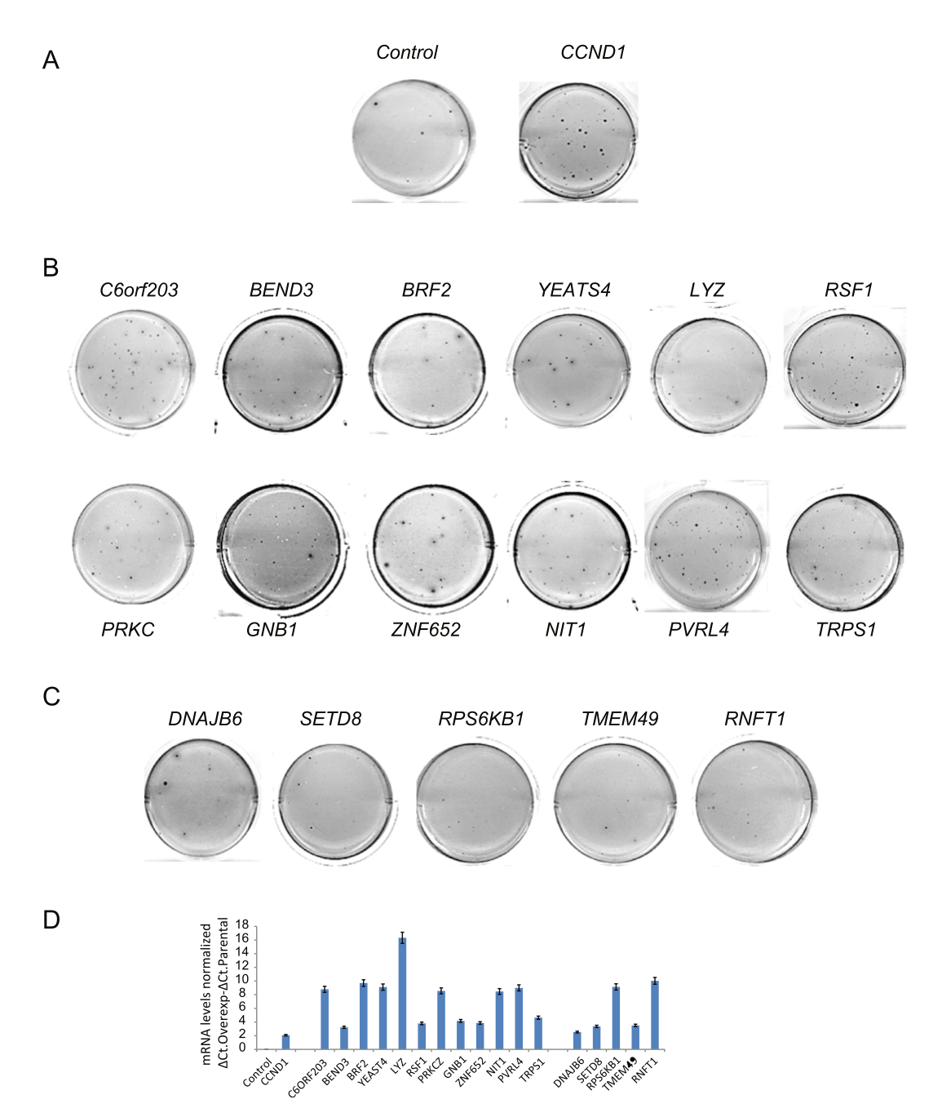
Results

Slide 14
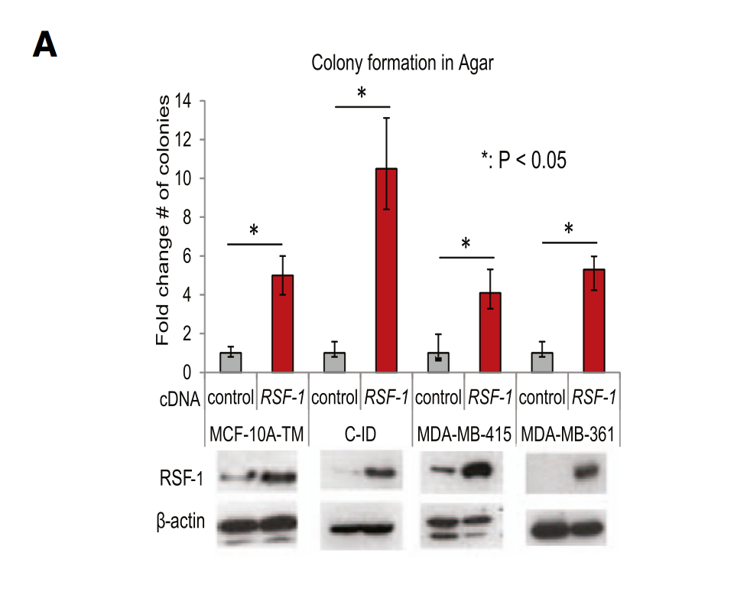
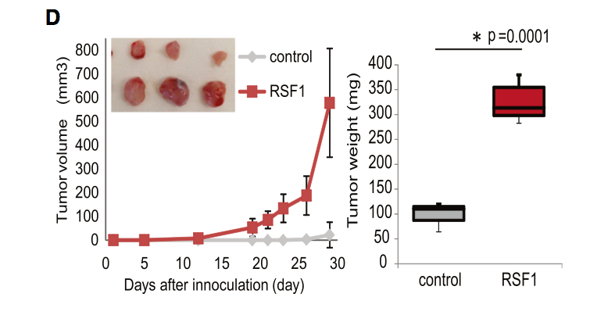
Results: RSF-1
Overexpression of RSF1 in CID cells

Slide 15
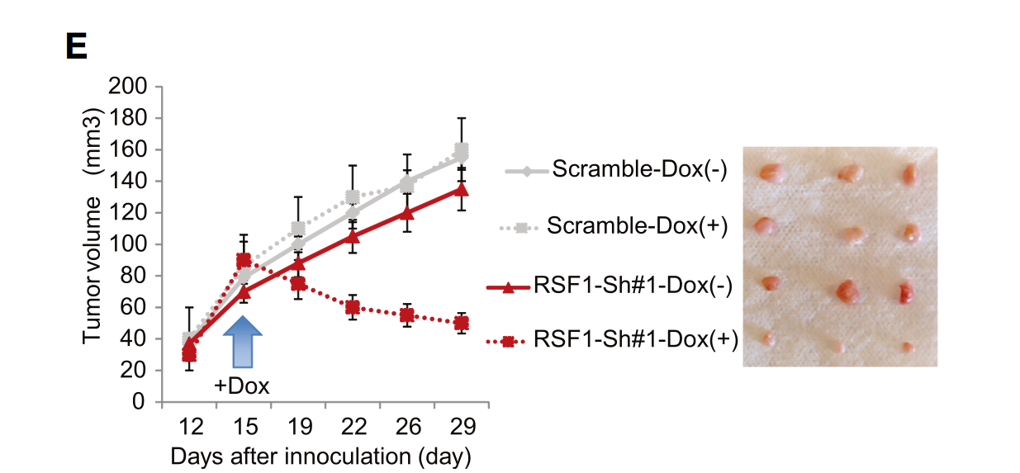
Results: Dox Inducible

Slide 16
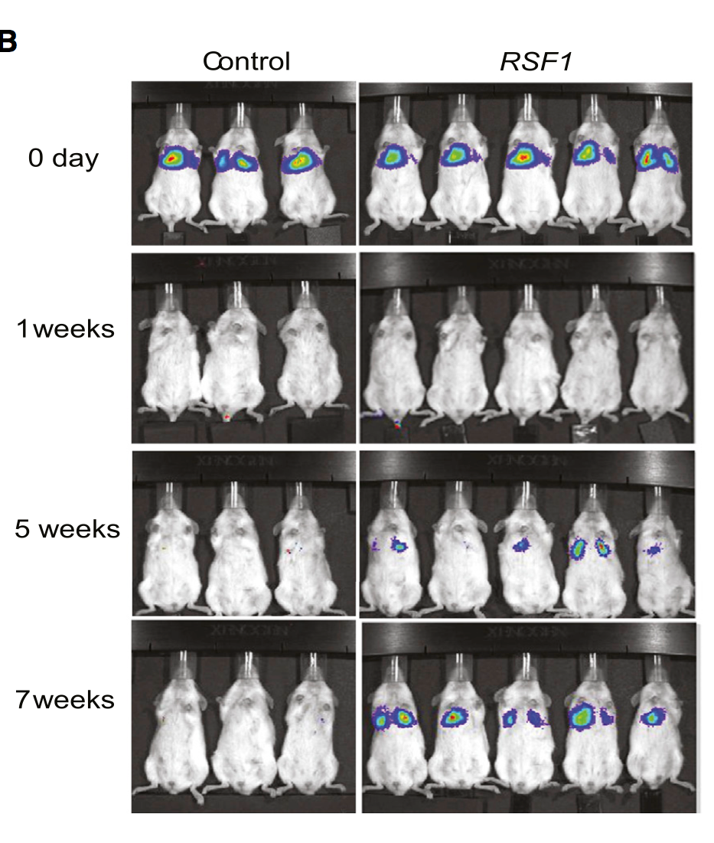
Results: Xenograft

Slide 17
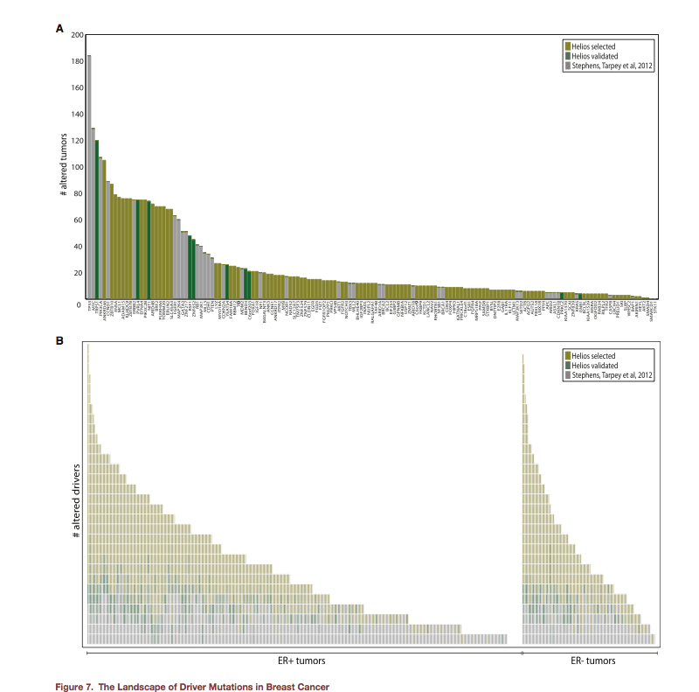
Results

Slide 18
Take Aways
A step forward in finding and validating driver genes
First time (to my knowledge) of a computation→ in vitro → in vivo study
Open up potential to incorporate therapeutic targets

